Slide 1

Detecting Hate Speech against Immigrants and Women on Twitter
Muhamad Irfan Hafiz Bin Muhamad Hanafi

Slide 2
Introduction
This project is based on the SemEval 2019 Task5 – Multilingual Detection of Hate.
My aim is to create a machine learning model that can:
Predict if a tweet is hateful or not
If Hateful, predict if the given tweet is target to an individual or a group
If Hateful, predict if the given tweet is aggressive or not aggressive

Slide 3
Content
Project Background
Showcase
Methodology
Experiments
Overall Results
Conclusion

Slide 4
Project Background
Context:
As of May 2020, on average, there has been around 6,000 tweets per second culminating to around 200 billion tweets per year. (Source)
It is impossible for a single human to read through so much information being sent around in the internet.
This leaves a huge blindspots on massive platforms such as twitter, if for example, they decided to tackle the herculean task of moderating their platforms.
This is where technology comes in to provide the necessary tools to assist in such huge undertakings.
Notes:
https://www.dsayce.com/social-media/tweets-day/
https://www.internetlivestats.com/one-second/#tweets-band

Slide 5
Tasks
Task A: Hate Speech Detection against Immigrants and Women
A binary classification where systems have to predict whether a tweet with a given target is hateful or not hateful

Slide 6
Task A
Evaluation:
Accuracy = Correct Prediction / Total Predictions Precision = Correct Prediction / Class Predictions Recall = Correct Predicted Labels / Number of Labels in Gold Standard?
F1-Score = (2*Precision*Recall) / (Precision + Recall)

Slide 7
Tasks
Task B: Aggressive Behaviour and Target Classification
Systems are asked to first classify hateful tweets as aggressive or not aggressive, and second to identify the targeted harassed as individual or generic

Slide 8
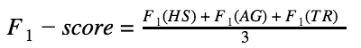
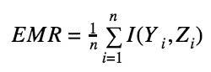
Task B
Evaluation:
Partial Match:
Exact Match:
Notes:
Explain what these numbers mean later

Slide 9
What is Hate Speech?
What definition of Hate Speech is being used?
https://github.com/msang/hateval/blob/master/annotation_guidelines.md

Slide 10
What is Hate Speech?
Insults, Threats, Denigrating or Hateful Expressions
Incitement of hatred, violence to groups or individuals of different physical and/or cultural traits, language and gender.
References to the alleged inferiority or superiority of some ethnic groups with respect to others
Delegitimating of social position or credibility based on origin/ethnicity
References to certain backgrounds/ethnicities as a thread to the national security or welfare or as competitors in the distribution of government resources
Dehumanization or assosciation with animals or entities considered inferior
Presumed assosciation of origin/ethnicity/gender with cognitive abilities, propensity to crime, laziness or other vices
Notes:
Summarize these in 2-3 sentences

Slide 11
Guidelines
Message must have immigrants/refugees/women or individuals that are considered to be part of that group to be the main target
Content should include messages that spreads, incites, promotes or justifies hatred or violence towards the target or a message that aims at dehumanizing, hurting or intimidating the target.
The presence of both aspects is essential to whether the data considers a tweet hateful or not
Notes:
Guidelines are based off https://github.com/msang/hateval/blob/master/annotation_guidelines.md

Slide 12
Guidelines
Target Language Labelling
A message can be considered as targeted towards an Individual or Generic
Individual: Unwelcome and Offensive messages purposely sent to a specific individual person
Generic: Messages intentionally posted to many potential victims belonging to a social group (immigrants, refugees, feminists)

Slide 13
Guidelines
Aggressive Language Labelling
A message is considered aggressive if it presents, incites, threatens, suggests or alludes to:
Attitudes, Violent Actions, Hostility or Commission of Offences against the target
Justify or Legitimize an aggressive action against the target

Slide 14
Examples
Immigrants:
Hateful but not aggressive, Generic:
“@UNITED how about donating flights to deport the Invaders back to their homeland. #DeportThemAll”
Hateful but not aggressive, Individual:
“You are a scrounger/soldier coming to create a caliphate or create chaos. Go home, look after your girlfriends/wives/kids. The last thing you are, are a refugee! Bugger off! Bye, bey, cheers....
Not Hateful:
“Hundreds of Syrian refugees started crossing the border from Lebanon on Saturday.”
“@USER Ireland is a neutral and independent country which is NOT part of any military alliance. Please do not forget that and act like Ireland is a vassal state of the UK or the EU. PLEASE DO NOT ENGAGE IN STUPID and DAMAGING ACTIONS AGAINST RUSSIA. Keep good relations with Russia!”

Slide 15
Examples
Women:
Individual
“Punch that girl right in the skank”
“@USER You ain’t shit bitch shut your whore mouth”
Generic:
“Fucking clueless women should stay in the kitchen and not ruin a good man’s name”
“sucking my own dick cause women are stupid”
Not all men are trash. But if you always pick the ones who are trash, or treat you like trash, then ya you’ll learn to hate them for sure!
Not Misogynous:
“Ex-Teacher Please Not Guilty to Rape Charges”
“*You couldn’t possibly value a girl if you still refer to women as “bitch”*😒”

Slide 16
List of Subjects that are NOT considered hate speech within the dataset
Hate speech against targets that are not immigrants/refugees or women
Offensive language
Blasphemy
Historical denial
Overt incitement to terrorism
Offense towards public servants and police officers
Defamation

Slide 17
Data Summary
If Hate Speech(HS) occurs against a given target (Women or Immigrants) it is labelled as (1) and if not it is labelled as (0).
If HS occurs, a binary value shows whether it is targeted to a generic group of people(0) or a specific individual(1)
If HS Occurs, a binary value shows if the tweet is aggressive (1) or not (0)

Slide 18
Data Summary
I am given three files
hateval2019_en_dev
hateval2019_en_test
hateval2019_en_train
I train my model with “hateval2019_en_train” and test it with “hateval2019_en_test”
Notes:
This will be important later as I can get discrepancy in my model accuracy

Slide 19

Demonstration

Slide 20
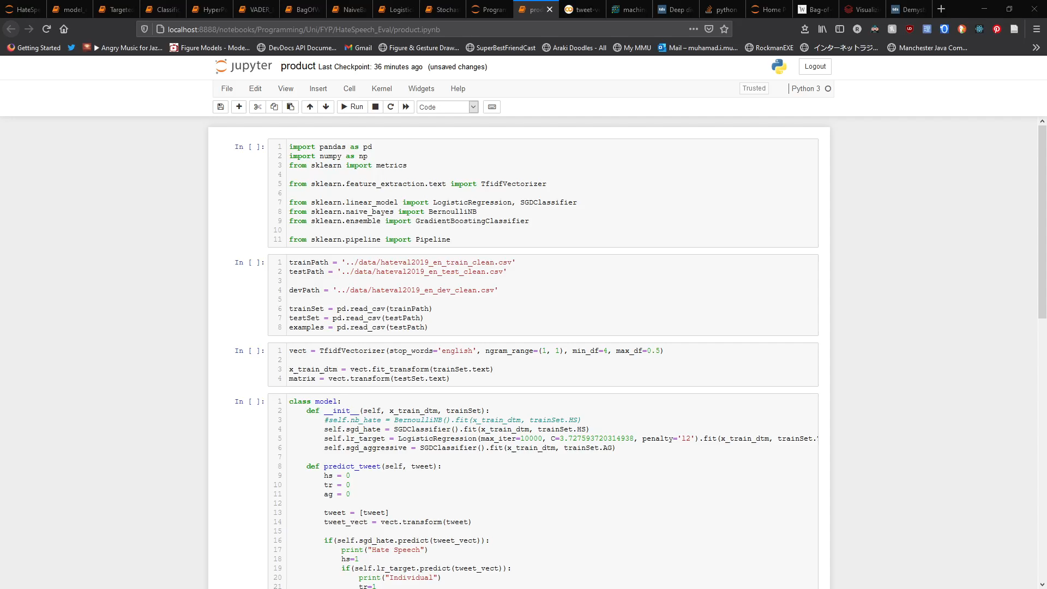

Slide 21
Methodology
Experiments
Hyperparameter Tuning and Model Training
Evaluation
Repeat

Slide 22
Metrics
Imagine there are 15 animals, 6 dogs and 9 cats
You have a pre-trained model that can identifies cats
The model guessed 9 animals as cats, 6 are actually cats (true positive) and 3 cats were missed (false negative)

Slide 23
Metrics
Accuracy
Number of correct predictions / total number of predictions, Accuracy would be 12/15
Precision
The number of true positives within all the classified positives , Precision is 6/9 (true positives / all positives)
Recall
The number of true positives in all relevant elements, Recall is 6/9 (true positive / relevant elements)
Notes:
Accuracy is not the most relevant metric to be considered.
In most circumstances, precision and recall are regarded to be more relevant as they concern themselves with the data that we are looking for.

Slide 24
Metrics
F1 Score
The harmonic mean of the precision and recall, with its highest value being 1.0
The goal is to have a score as close to 1.0 as possible
F1 Score = 2 * ( precision * recall / precision + recall )
2 * ((6/9 * 6/9) / (6/9 + 6/9)) = 0.6666
Notes:
What are harmonic means? What is an F1-Score exactly? I know the formula but what does it actually represent in real life?
Also relate back to how this is relevant to hate speech.
How does a higher F1-Score show that the model is “better”?
Think of F1-Score as an average or mean for relevant data.
There are circumstances where a model can have a high accuracy in predicting something but there are moments where having false negatives are costly.
For Example: when you have data that are biased in a certain direction, the model would have no problem predicting most of the data but the few that it does miss out will ruin everything

Slide 25
Metrics
True Positive Rate = True Positive / True Positive + False Negative
False Positive Rate = False Positive / False Positive + True Negative
Receiver Operating Characteristic Curves
Shows the performance of one classification model at classification thresholds, it can be used to evaluate the strength of a model.
It’s a plot of True Positive Rate(TPR) on the y-axis vs False Positive Rate(FPR) on the x-axis
It can be used to determine the optimal threshold
Area Under Curve
The area under curve provides an aggregate measure of performance of a model across all possible classification thresholds
AUC can tell how much the model is capable of distinguishing between classes, the higher the AUC the better the model is at predicting the probability of true positive.
AUC ranges from 0 to 1

Slide 26
Experiments
Data Preparation
Bag of Words Experiments
VADER Experiments
Classification Models Experiments
Hyperparameter Tuning with GridSearch experiment
Manual Fine-Tuning
Notes:
How do I conduct these experiments?

Slide 27
Data Preparation
Due to the criteria of the task saying that Targeted and Aggressive Speech are to be recorded only if hate speech is present, I tried splitting the data for vectorisation and classification to see if it would have an effect
Notes:
How do I conduct these experiments?

Slide 28
Bag of Words
A text is represented as a set of its words, disregarding grammar and word order but keeping the frequency of occurrences.

Slide 29
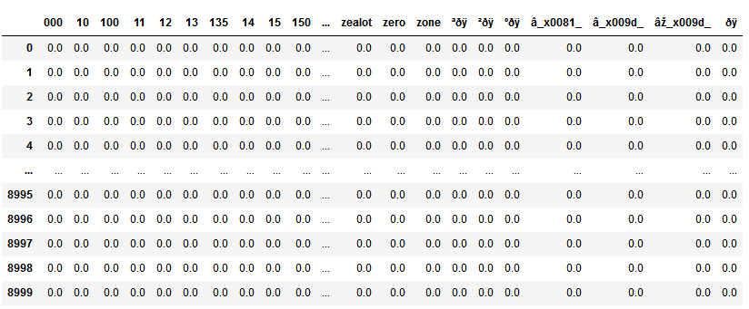
Bag of Words
What is inside the vectorizations

Slide 30
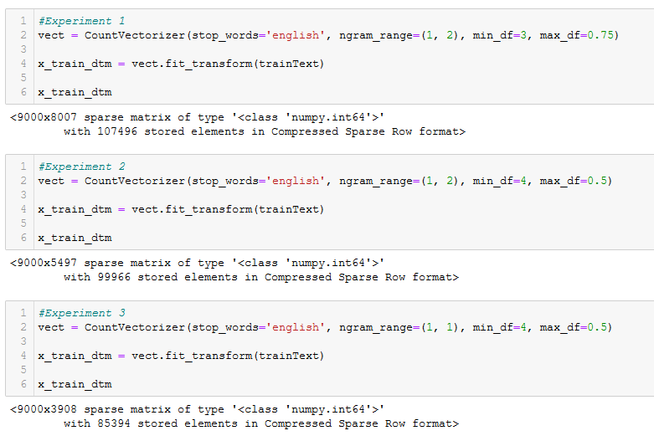
Bag of Words
How the size of the matrices are different based on the different parameters chosen for Bag of Words
Notes:
For the 9000 tweets, the column space is variable as it records different amounts of unique terms for the Matrix

Slide 31
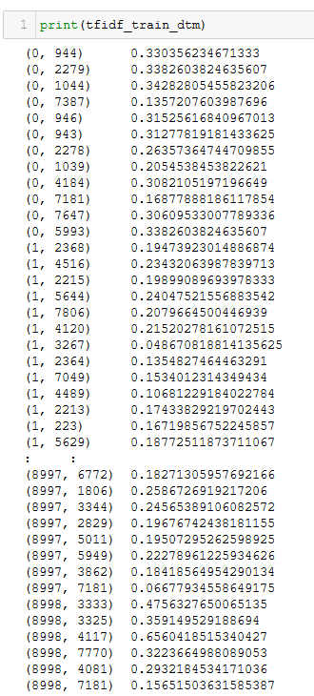
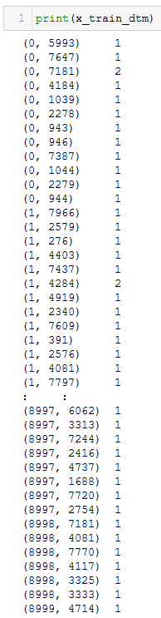
Bag of Words
With TF-IDF
Without TF-IDF
TF-IDF – “Weighting Factor” for text-mining, the value increases proportionally to the number of times a word appears within a document and is offset by the number of documents that contains the word
Notes:
Term Frequency-Inverse Document Frequency
Inverse Frequency will diminish the importance of words like “The”

Slide 32
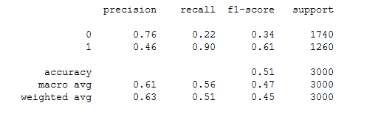
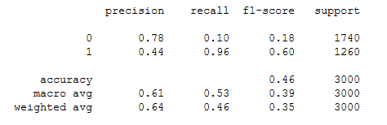
Bag of Words
With TF-IDF
Without TF-IDF

Slide 33
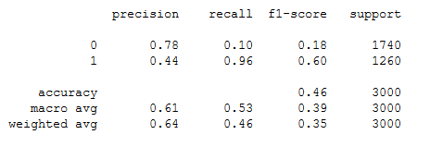
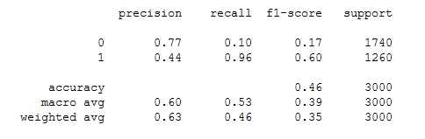
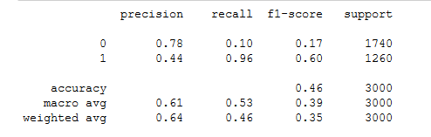
Bag of Words
N-Grams – Grouping up words. A bi-gram would group up two words together, Ex: ”hate”, “group”, “hate group”
Monogram
Bi-gram
Tri-gram

Slide 34
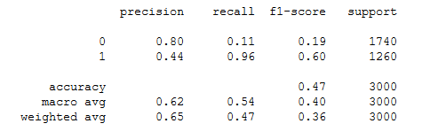
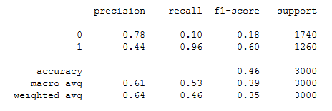
Bag of Words
Min-DF: Removes words that occur infrequently, the lack of appearances within the dataset would show that it is not relevant to the overall trend that the classification models are trying to look for

Slide 35
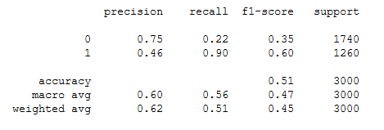
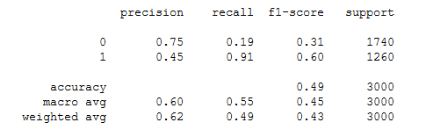
Bag of Words
Max-DF : Removes frequently occurring words, this would make common words that hold little value such as articles and other grammatical features to be valueless and discarded. It filters out noise but risk removing information
0.25
0.75

Slide 36
Bag of Words
Stop-Words: Pre-existing library that contains common words that would be excluded for vectorization of data due to being uninformative and irrelevant.

Slide 37
Semantic Analysis
Using VADER as another feature value in the data.
VADER is a Semantic Analysis tool that classifies a given message with numbers indicating the probability that it is positive, negative and the overall probability.
How does it affect the results?

Slide 38
Semantic Analysis
“Why would young fighting age men be the vast majority of the ones escaping a war &amp; not those who cannot fight like women, children, and the elderly?It's because the majority of the refugees are not actually refugees they are economic migrants trying to get into Europe.... “
Hate Score: 1.000000
Target Score: 0.000000
Aggressive Score: 0.000000
---VADER SEMANTIC ANALYSIS---
Positive Score: 0.062000
Neutral Score: 0.783000
Negative Score: 0.155000
Compound Score: -0.729100
How VADER works
trainset index 1

Slide 39
Semantic Analysis
“still places on our Bengali (Sylheti) class! it's London's 2nd language! know anyone interested @USER @USER @USER”
Hate Score: 0.000000
Target Score: 0.000000
Aggressive Score: 0.000000
---VADER SEMANTIC ANALYSIS---
Positive Score: 0.162000
Neutral Score: 0.838000
Negative Score: 0.000000
Compound Score: 0.508000
How VADER works
trainset index 8

Slide 40
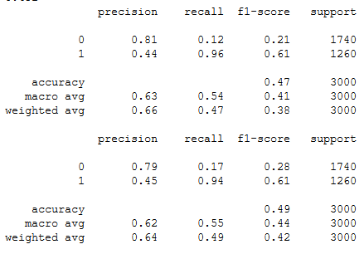
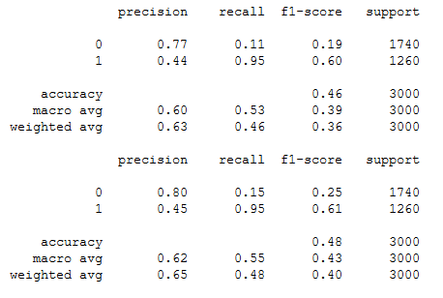
Without VADER
With VADER
Notes:
Sadly it does not reflect on the results,
Top, Bernoulli Naïve Bayes
Bottom, Stochastic Gradient Difference
There could be a number of reasons for this

Slide 41
Classification Models Experiments
Bulk Testing
Parameters: CountVectorizer(stop_words: ‘English’, ngram_range=(1,2), min_df=2, max_df=0.5)
Classification Models Tested:
Multinomial Naïve Bayes
Bernoulli Naïve Bayes
Gaussian Naïve Bayes
Logistic Regression
Stochastic Gradient Descent
Support Vector Machine
Random Forest
Gradient Boosting
Notes:
How do I conduct these experiments?

Slide 42
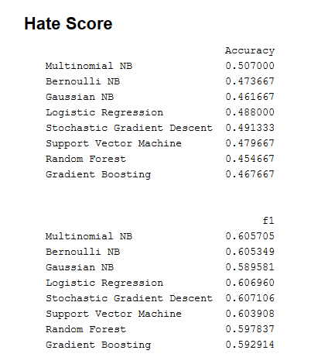
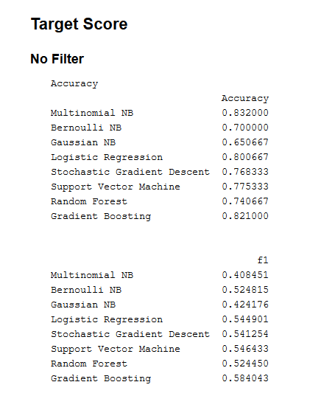
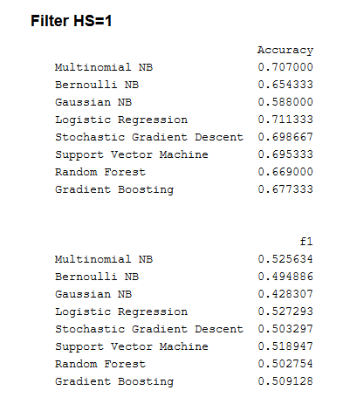
Classification Models Experiments
Notes:
How do I conduct these experiments?

Slide 43
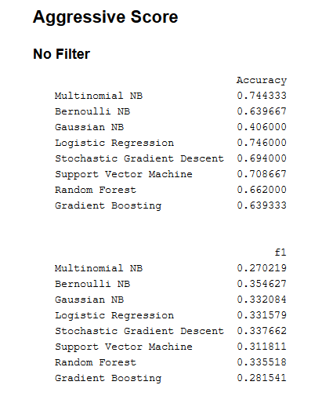
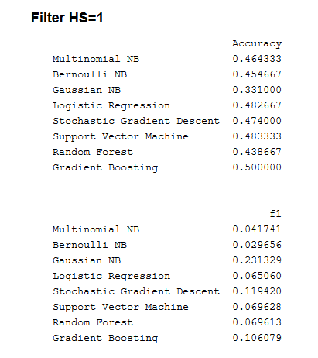
Classification Models Experiments
Notes:
How do I conduct these experiments?

Slide 44
Experiments
Hyperparameter Tuning with GridSearch
Missing Parameters
Long Time to Compute Results if Set-Up incorrectly due to exponential increase in folds
Notes:
How do I conduct these experiments?

Slide 45
Experiments
Manual Fine-Tuning
Use of Confusion Matrices
ROC Curves + AUC
Notes:
How do I conduct these experiments?

Slide 46
Naïve Bayes
Guesses based on Probabilities from words that appear
Multinomial NB
Bernoulli NB
used for discrete data, where features are in binary form
Gaussian NB
use of normal distributions Bernoulli was picked due to being the most consistent best performing classifier
Notes:
Bernoulli might be the best performing out of all the other naïve bayes models as it is designed to work with binary outputs which is what we have in our data set, where each different type of scores assigned to a given tweet can be found as 0 or 1. (How does it interact with the vectorized data-set though? Ans: Binary Output is the actual thing that Bernoulli concerns itself with)

Slide 47
Naïve Bayes
Manual Testing based on Optimal Hyperparameters
Results are more-or-less the same with some slight variance in F1-Score
A big issue with the models performances are that they have a lot of false positives

Slide 48
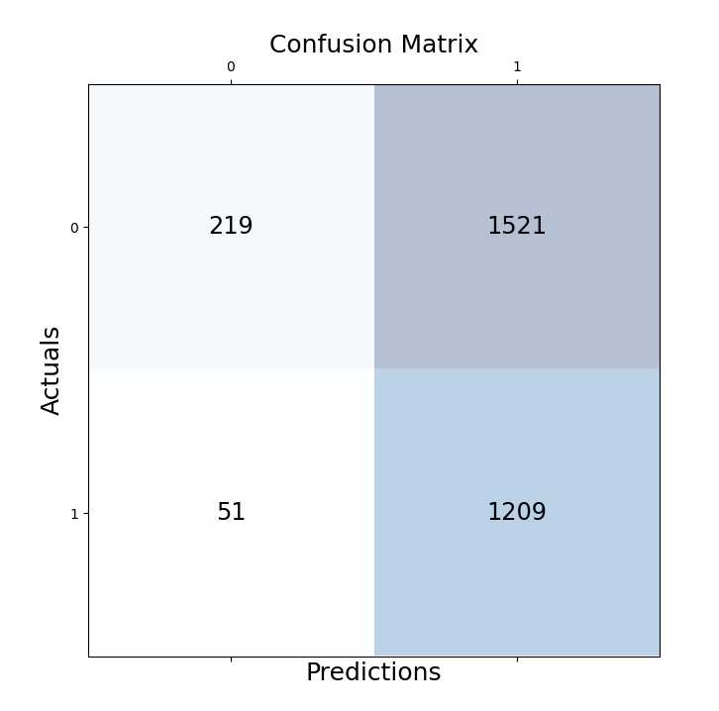
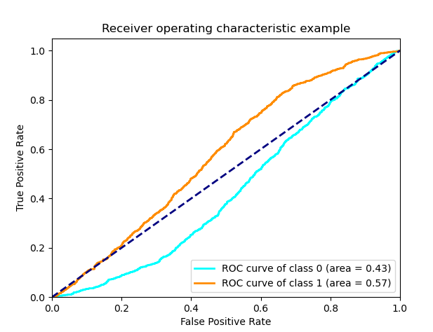
NB Metrics
Hate Score

Slide 49
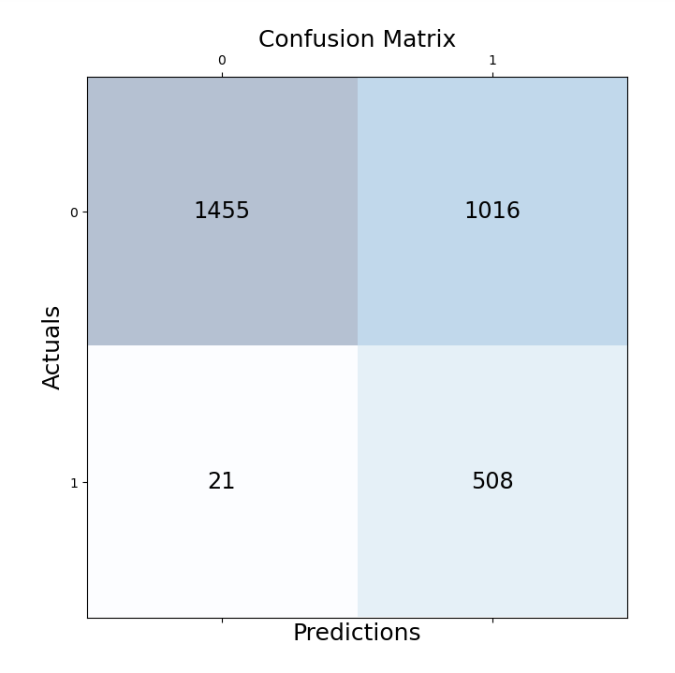
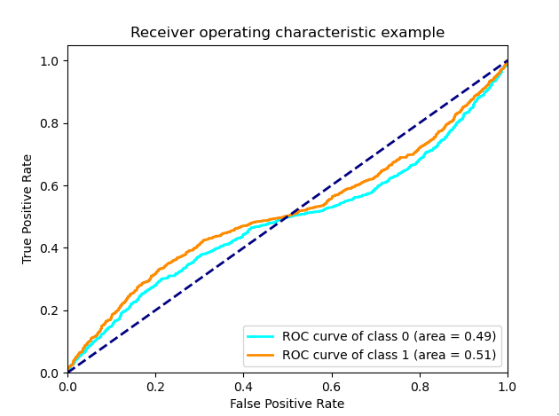
NB Metrics
Target Score

Slide 50
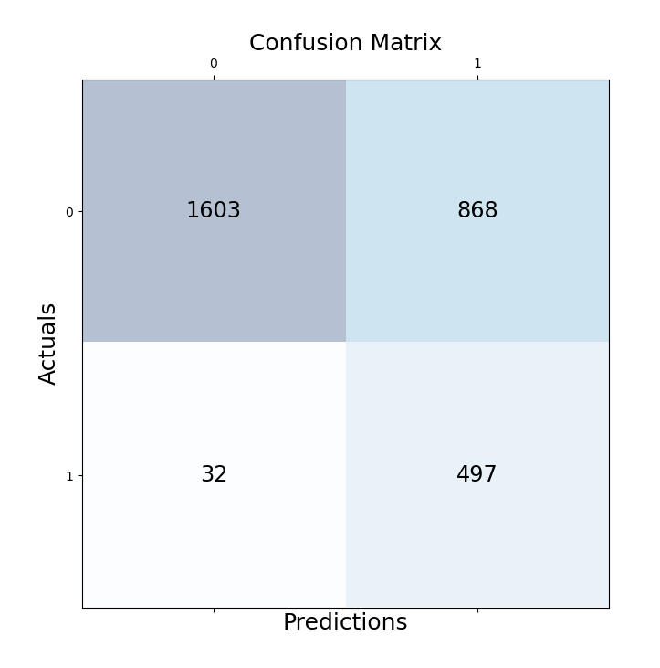
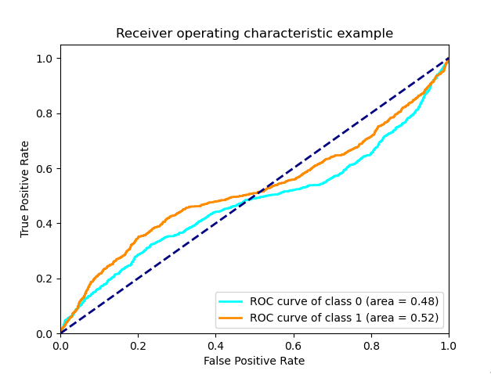
NB Metrics
Aggressive Score

Slide 51
NB Metrics
Overall F1-Score: 0.4951
EMR: 0.2020

Slide 52
Linear Models
Logistic Regression
Stochastic Gradient Descent

Slide 53
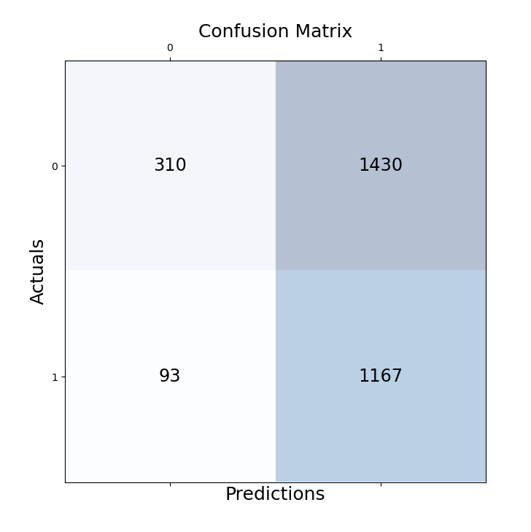
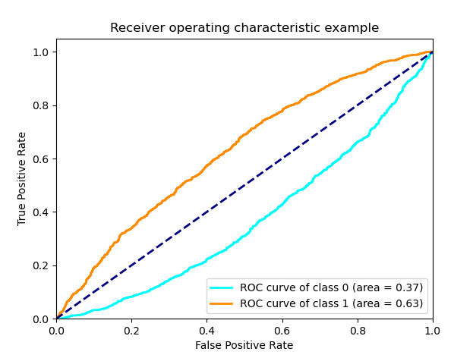
LR Metrics
Hate Score

Slide 54
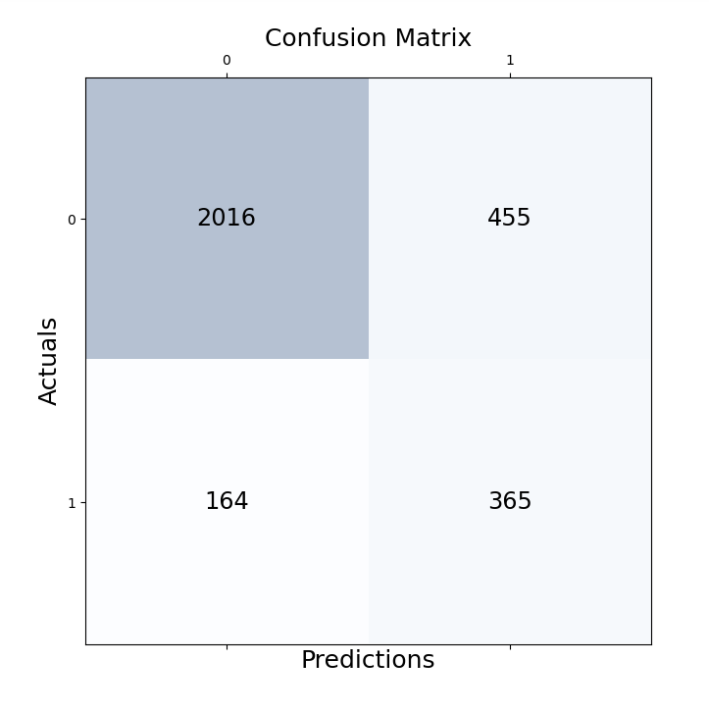
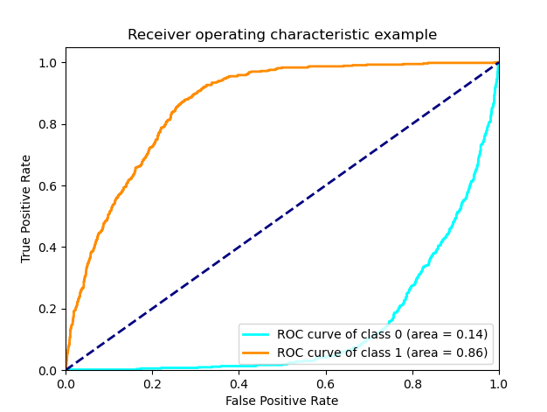
LR Metrics
Target Score

Slide 55
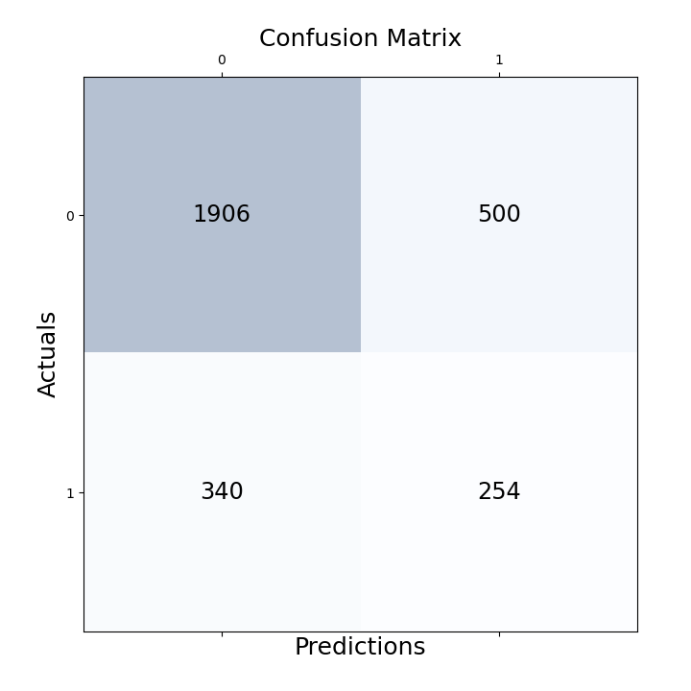
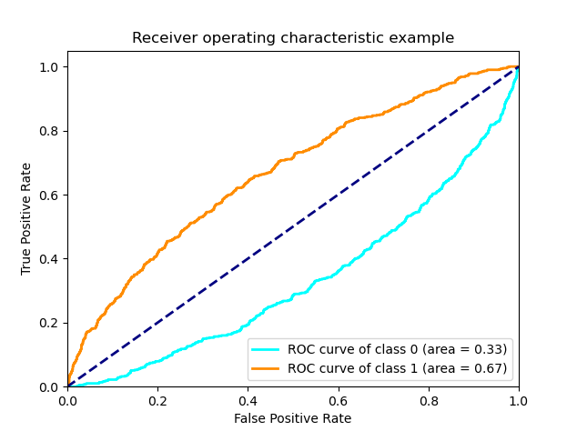
LR Metrics
Aggressive Score

Slide 56
LR Metrics
Overall F1-Score: 0.5077
EMR: 0.2257

Slide 57

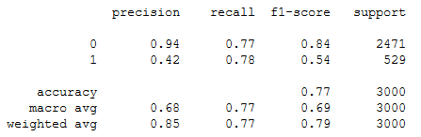
SGD Metrics
Target Score

Slide 58
SGD Metrics
Overall F1-Score: 0.4967
EMR: 0.2044

Slide 59
Overall Results
BernnouliNB(Hate Score)
Logistic Regression(Target Score)
Stochastic Gradient Descent(Aggressive Score)
Product utilizes the best performing models

Slide 60
Conclusion

Slide 61
Challenges, The Future and Conclusion
Challenges
Scope (Not sure how much to cover leading to overwhelming amounts of theory to understand)
Research Inexperience, leading to messy research and documentation
Future
“Portable” trained model, that can be used in web-applications
More organized research and documentation
I suspect most of these data are overfitted as train-test split has better results (however it doesn’t seem to scale that well), need to utilize more ways to eliminate noise from vectorised data
Experiments with different methods of feature extraction such as BERT, Deep Learning , Neutral Networks
More in-depth research on how certain parameters and methods mathematically affect predictions made by machine learning algorithms

Slide 62
Promise and Limitations
Common Misconceptions
Artificial Intelligence will figure out the solution to problems by itself
Impartiality of Data (Importance of Diversity)
Promise
Moderation, Research
Notes:
1. Not quite accurate as it is heavily reliant on what data is being fed to it and what conditions have been set for it. It is highly dependant on the discretion of the engineer behind it. This can be seen in how the data is classified (For Example: Racial Profiling, Beauty Standards –Need Sources?-).
To go back to the current task, it is impossible for me to go through all of the tweets I have used for training to determine if they have been correctly labelled with the scores they received. I have to trust on the judgements made by other parties. If the model were to be given bad data to train on, it will perform outside of what is expected.
2. Data isn’t impartial, what doesn’t get measured is also an important decision that has to be made and this is where unconscious biases are the most prevalent

Slide 63
Questions?

